Slide 1
5 Ways AI Will Enable Recruiting to Be More Human, Not Less
Ben Eubanks @BenEubanks
Notes:
How can we automate without losing the personal connection?
Where are candidates most comfortable being connected to an algorithm in the hiring process?
Where is the best place for employers to balance automation with recruiters?
When will candidates stop calling to “check on the status” of their application?

Slide 2
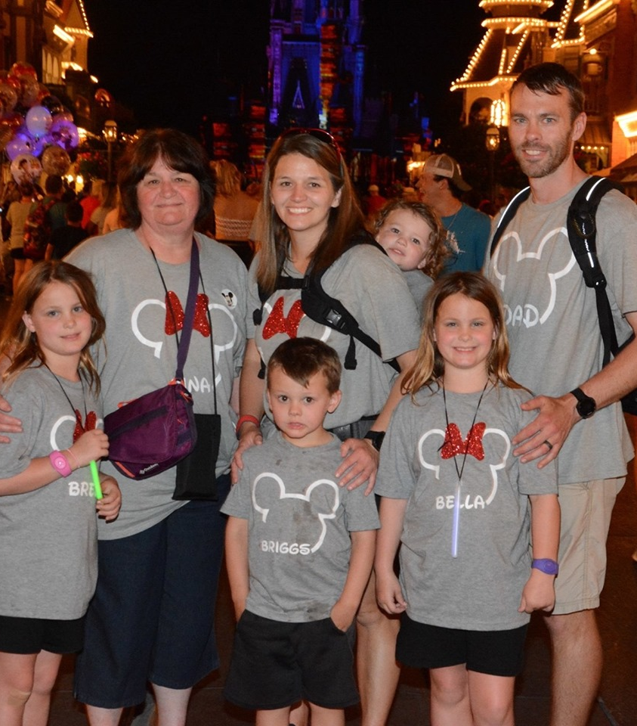
Internationally recognized research and advisory on technology, talent strategy, innovation, and more
Author: Artificial Intelligence for HR
Host: We’re Only Human podcast—focus on talent trends and technologies

Slide 3
More, or less?

Slide 4
Defining AI and Market Scope
Notes:
You’re not a data scientist, you’re an HR Leader. Book: shortest chapter for a reason.

Slide 5
What is AI?
The lack of a precise, universally accepted definition of AI probably has helped the field to grow, blossom, and advance at an ever-accelerating pace.
–Stanford University

Slide 6
Components of AI
Machine learning
Natural language processing
Examples
Streaming video algorithm
Computer vision
Voice assistants
Notes:
ML and NLP components. ML—machines produce calculations and are supervised by data scientists to help make predictions more accurate over time. Another model is used by pitting a machine against itself to learn the possible variations and permutations and reach an intended goal. AlphaGo vs Zero.

Slide 7
AI Technology Funding
2017: ~$1 billion in HR Tech funding overall
Half of 2017 funding went to companies targeting AI tech
2018: 4x increase in overall funding
2019: starting to see outcomes from those investments
Notes:
The thing is this will continue to be part of the landscape.

Slide 8
The Value Promise of AI
Automation
Augmentation
Personalization
Notes:
Highly personalized experiences that scale. What you hire 90,000 people a year? I interviewed ALliedUniversal recently and that’s their reality. AI could help them create personalized interactions for all those visitors.
Automation: if I had to ask you how much of your work is repetition of a process, how much would you estimate? 20% 80%? Wherever it falls on that scale there are opps to automate components of that. Automation targets: high volume and high cost of error.
Augmentation: what kinds of things do you rely on? My phone tells me when to leave before meetings so I’m not late, gives me recommendations on best routes, and more. I remember being excited two years back when Microsoft unveiled LinkedIn integrations so you could see the background of meeting attendees prior to a conversation, helping you be better prepared.

Slide 9
AI in Talent Acquisition Technology
Notes:
You’re not a data scientist, you’re an HR Leader. Book: shortest chapter for a reason.

Slide 10
Amazon’s Hiring Case Study

Slide 11
5 Key Areas of Impact
Chat bots
Automated sourcing
Recruiter coaching
Unbiased algorithms
Targeted insights
Notes:
These are the headliners. Ways recruiting can be more human, not less, with AI technologies at our disposal. Let’s dig into each one with some examples.

Slide 12
20+ vendors
Candidate engagement & scheduling, talent pool re-engagement
Conversational interface
Increasing personalization
LHRA.io/AIREC
Engagement via Chatbot
Notes:
Dozens and dozens of companies using chat bots to support candidate interactions. I’ve seen chat functionality for some sites that puts people in touch with a recruiter, but one company’s experiment showed that more than 60% of interactions happened during non work hours. Questions: salary, job specifics, company information, recruiting process, culture/environment, general.
Advanced applications: brand ambassadors. Scoring social media presence.
Advanced applications: apply for a job. It looks at your linkedin profile and sees that you’re a volunteer board member for women’s rights nonprofit. Some tools can then come back to you during the conversation with comments about the company’s commitment to those types of initiatives (assuming it’s really true) so they build a rapport. Just like a great recruiter.

Slide 13
Case Study
Employees: 62,000
Problem: applicant screening volume
Solution: front-end chatbot for candidate engagement
Result: able to interact with every candidate in scalable way, offering personalized experiences

Slide 14
Automated sourcing/outreach
Matching using semantic analysis
Sourcing and Matching
Notes:
Sourcecon story: sourcers vs bot. Talk about the experience but STOP before telling results.
What specific activity does a sourcer carry out that adds most value to process? Is it looking for ways to connect in more personal ways? Is it searching for those really unique individuals?
The goal of automated sourcing tools is to help them do mor of those things. Example: you put in search parameters for a new requisition and go home for the day. When you come back to the office the system lets you know it found five, reached out to them, and two are interested in talking with you.

Slide 15
The Grand Master Challenge

Slide 16
Automated screening for candidates
Assessments can take 60 seconds to 30 minutes or more
Common formats: video, games
Screening and Assessments
Notes:
If you manage a team of recruiters, can you imagine what would happen if everyone was as good as your best recruiter? Or if you’re a solo team or a small team, think about the best recruiter you’ve ever worked with. What if you could perform at that level? AI technology is going to help make that a reality.
Using a system of notifications to nudge the right behaviors and help us change our results. Also, if the system can see performance it knows which decision points led to positive results and which did not.
Learning technology example: crunch performance and feedback data, then give recommendations on how to close gaps in knowledge or skills. Easy transition here: use candidate experience data, performance reviews, and recruiting metrics to do the same thing, giving tailored advice to each person to help them improve.

Slide 17
Case Study
Employees: 169,000
Problem: volume and lack of diversity
Solution: automated front end with video interviews and game-based assessments
Result: 3x colleges reached, 75% reduction time to fill, increased diversity candidates, 82% satisfaction

Slide 18
Harvard/Sweeney research
Algorithmic Bias vs Human Bias
Examples
Augmented Writing
Adverse Impact Analysis
Assessments
Human and Machine Bias
Notes:
If you manage a team of recruiters, can you imagine what would happen if everyone was as good as your best recruiter? Or if you’re a solo team or a small team, think about the best recruiter you’ve ever worked with. What if you could perform at that level? AI technology is going to help make that a reality.
Using a system of notifications to nudge the right behaviors and help us change our results. Also, if the system can see performance it knows which decision points led to positive results and which did not.
Learning technology example: crunch performance and feedback data, then give recommendations on how to close gaps in knowledge or skills. Easy transition here: use candidate experience data, performance reviews, and recruiting metrics to do the same thing, giving tailored advice to each person to help them improve.

Slide 19
But…

Slide 20
Comfort Level with AI/Automation in Recruiting
Sourcing/Contact
Screening
Assessing
Offer
Hire
Onboarding

Slide 21
AI, Ethics, and Human Work
Notes:
You’re not a data scientist, you’re an HR Leader. Book: shortest chapter for a reason.

Slide 22
Vendor Considerations
Target Bias
Improve Decision-Making

Slide 23
Buyer Considerations
Will AI be used to create a more human experience, or not?
Automation History: jobs remaining are more human than before.

Slide 24
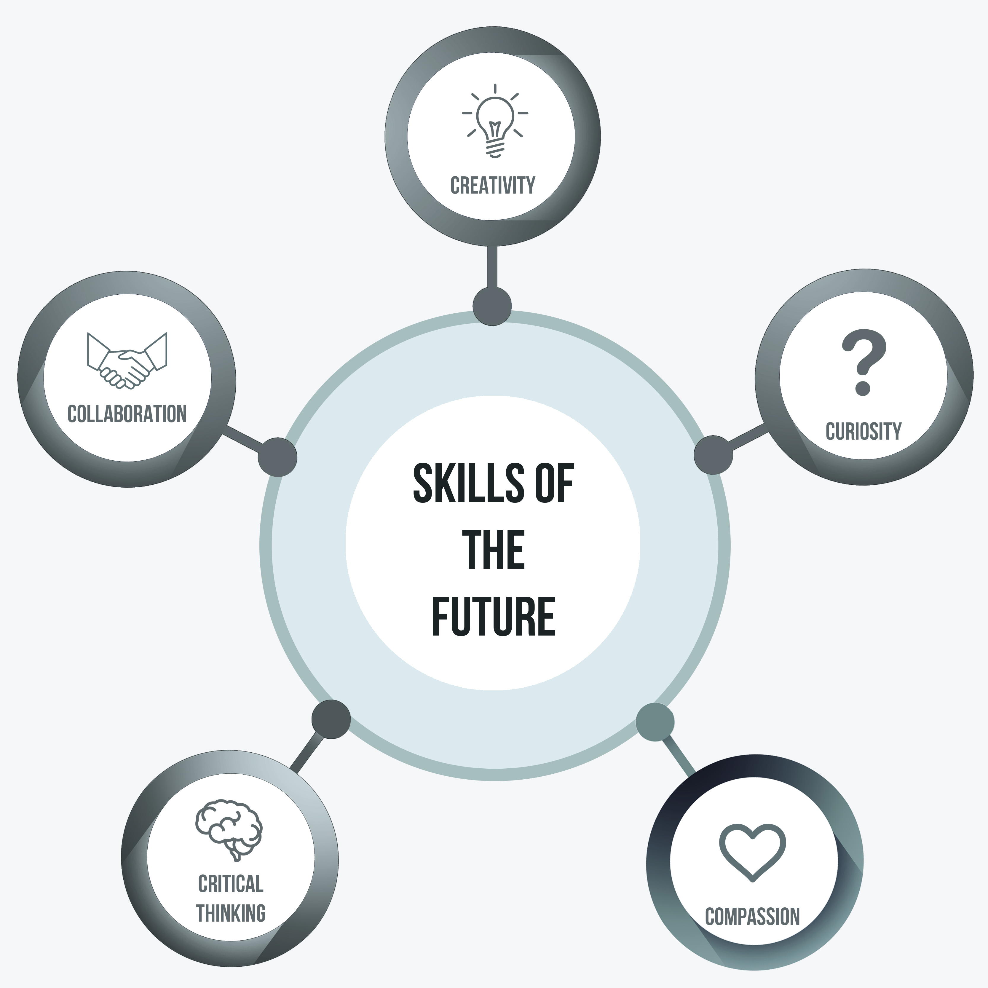
Skills for an AI-Driven Workplace
Creativity – Randy Bailey
Curiosity – “The Provisioner”
Compassion – Virgin Media
Collaboration – H&R Block
Critical Thinking – Credit Suisse
Notes:
Randy Bailey sourcer at Walmart in the sourcecon grand master competition. Rest of the story…
Curiosity: john medina brain research: we are hardwired to explore. Whether physical environments or virtual ones, such as problem solving. The thing is recruiters are presented with some tough problems daily and we need to find ways around them. Why? Why? Why? Toddler mindset.
Compassion: how do you treat your silver medalists? Virgin media realized it was doing this poorly. Now credits $7M revenue stream.
Collaboration: how many of you can get your work done with out any interaction or support from the business? Even our most basic metrics as recruiters are dependent on others. Time to Fill—if you’ve ever missed the mark on this because a manager sat on the resumes for a week before responding, you know exactly what I’m talking about. H&R block story.
Critical Thinking: what if your best candidates aren’t outside, but inside? Credit Suisse internals first… How can we think about problems in a way that gets us to a solution that others might skip? It also fits here—Randy Bailey said that he thinks human tenacity, not stopping when the going gets tough, is what separates us from machines. While we can’t out calculate a calculator (Haraguchi) we can find ways to think beyond the problem when computers can’t

Slide 25
If you train yourself to be a robot, then you’re out of a job. Gordon Sandford, Deloitte
Universities could substantially increase the value… if they spent more time teaching their students critical soft skills. ManpowerGroup
The most in-demand skills today aren’t coding or technical in nature. They are soft skills. Jeff Weiner, CEO of LinkedIn
Notes:
We need to be looking at ways to differentiate our skills and our competencies. What can you do that a computer can’t, and how can you improve those areas? If our education and training are both geared toward helping people do one process over and over, we’re failing. My joke in the book is if you have someone on your team that’s great at crunching numbers, they might want to find another skill set fast. A big action for you to take and walk away from this session? What unique skills do you have and how can you continue learning and honing them?

Slide 26
Get The Research LHRA.io/airec

Slide 27
Questions?
Ben.Eubanks@LHRA.IO
LHRA.IO

